Slide 1
Posexplode_outer:
- Unlike posexplode, if the array or map is NULL, explode_outer returns NULL.

Slide 2
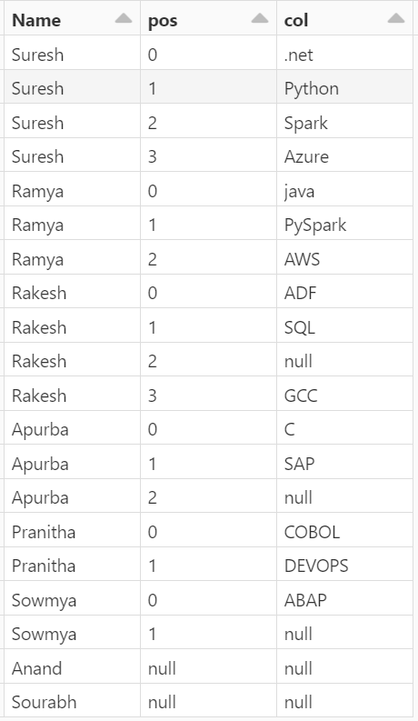
data = [(1, "Suresh", [".net", "Python", "Spark", "Azure"]),
(2, "Ramya", ["java", "PySpark", "AWS"]),
(3, "Rakesh", ["ADF", "SQL", None, "GCC"]),
(4, "Apurba", ["C", "SAP", None]),
(5, "Pranitha", ["COBOL", "DEVOPS"]),
(6, "Sowmya", ["ABAP", None]),
(7, "Anand", None),
(8, "Sourabh", [])]
schema = ["id", "Name", "skills"]

Slide 3
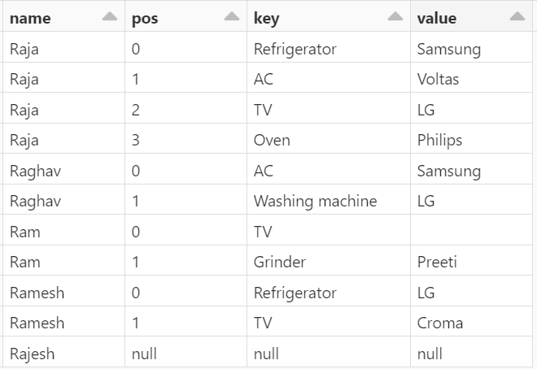
data1 = [('Raja', {'TV':'LG', 'Refrigerator':'Samsung', 'Oven':'Philips', 'AC':'Voltas'}),
('Raghav', {'AC':'Samsung', 'Washing machine': 'LG'}),
('Ram', {'Grinder':'Preeti', 'TV':""}),
('Ramesh', {'Refrigerator':'LG', 'TV':'Croma'}),
('Rajesh', None)]
schema1 = ['name', 'brand']
df1 = spark.createDataFrame(data=data1, schema=schema1)
display(df1)

Slide 4
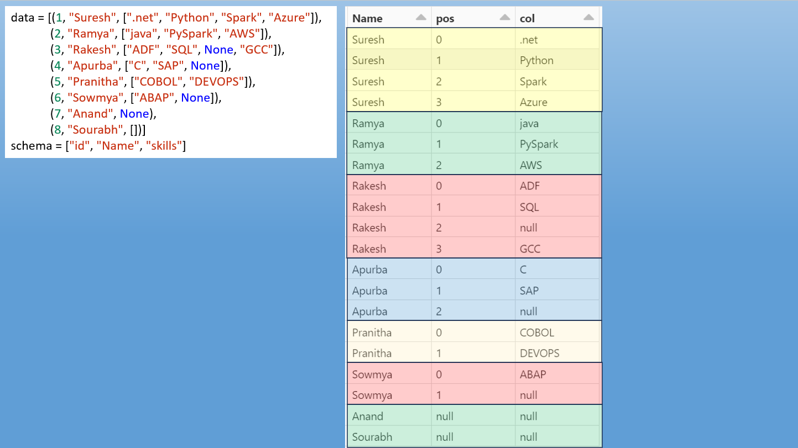

Slide 5
